Slide 1
Auto-Encoding Variational Bayes
By Kingma and Welling

Slide 2

The paper question ?
How can we perform efficient inference and learning in directed probabilistic models with presence of 2 challenges :
Continuous latent variables with intractable posterior distributions.
Large datasets.

Slide 3
Realistic Example
Recommendation Systems with Directed Probabilistic Models:
A streaming platform (e.g., Netflix or Spotify) aims to recommend personalized content to users. This involves:
Large-scale data (millions of users and items).
Continuous latent variables (user preferences and item attributes).
Intractable posterior distributions due to complex interactions between users and items.

Slide 4
Solution
Using The variational Bayesian (VB) approach involves the optimization of an approximation to the intractable posterior.
Drawbacks :
It requires analytical solutions of expectations w.r.t. the approximate posterior, which are also intractable.

Slide 5
Novel solution

Slide 6
Solution
Reparameterization of the variational lower bound
A simple estimator
Use:
SGVB (Stochastic Gradient Variational Bayes) estimator can be used for efficient approximate posterior

Slide 7
Auto Encoding VB (AEVB) algorithm.
Case of use :
i.i.d. dataset and continuous latent variables per datapoint
Aim :
Perform very efficient approximate posterior inference using simple ancestral sampling.
Tools:
Using the SGVB estimator to optimize a recognition model.

Slide 8
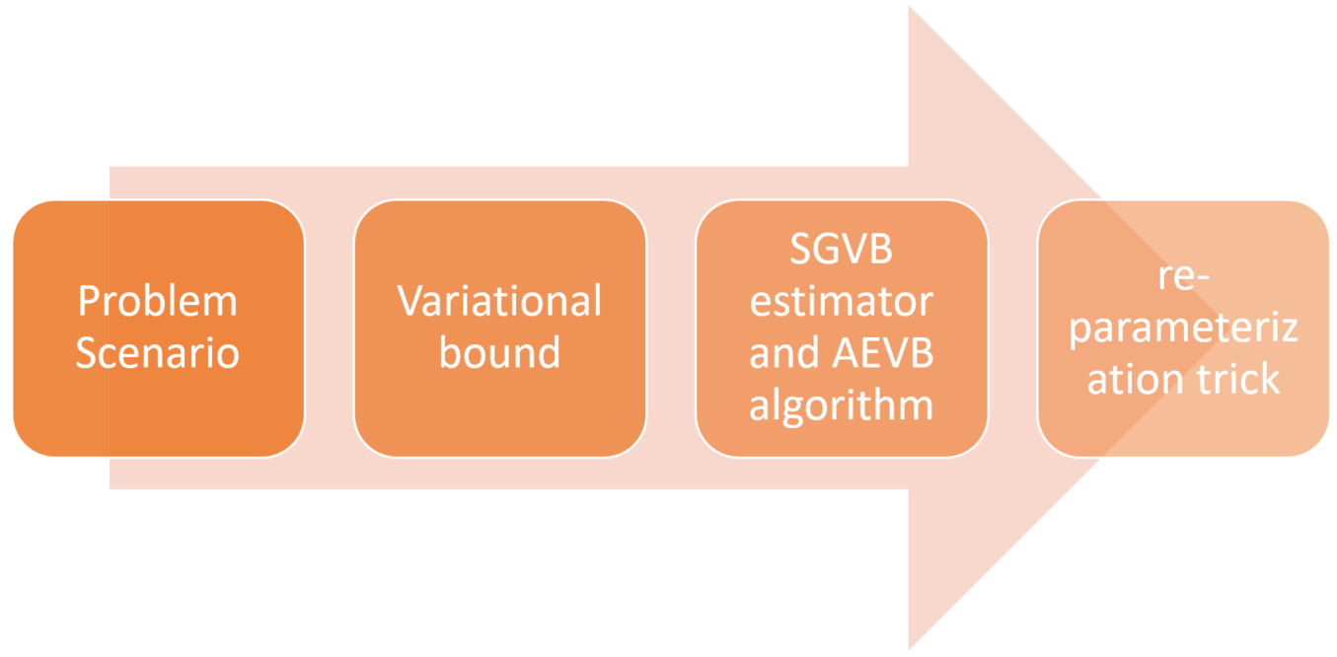
Methodology

Slide 9
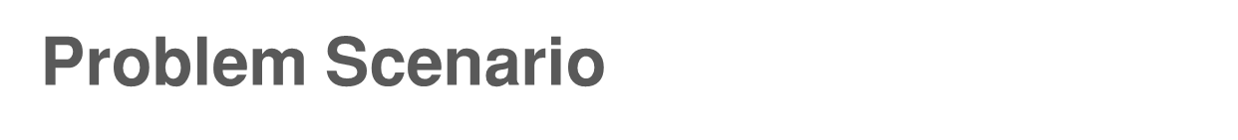
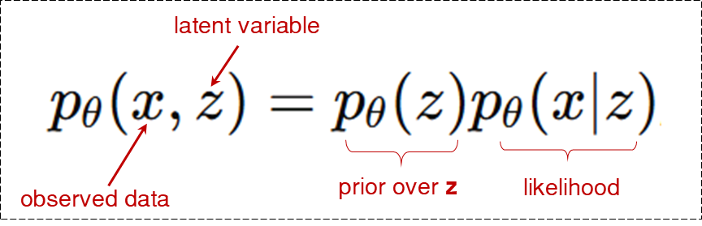
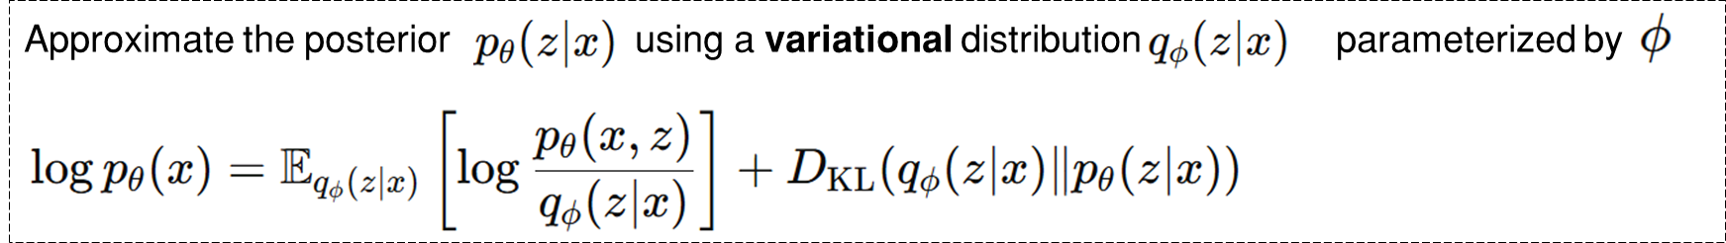
Intractability
Large datasets
Difficulty computing posteriors

Slide 10
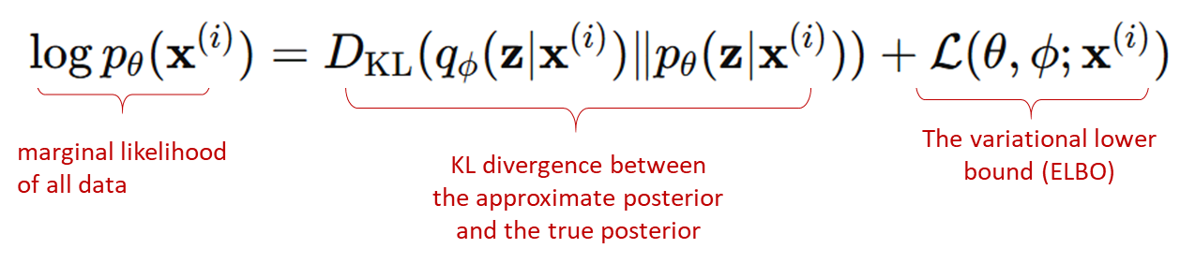
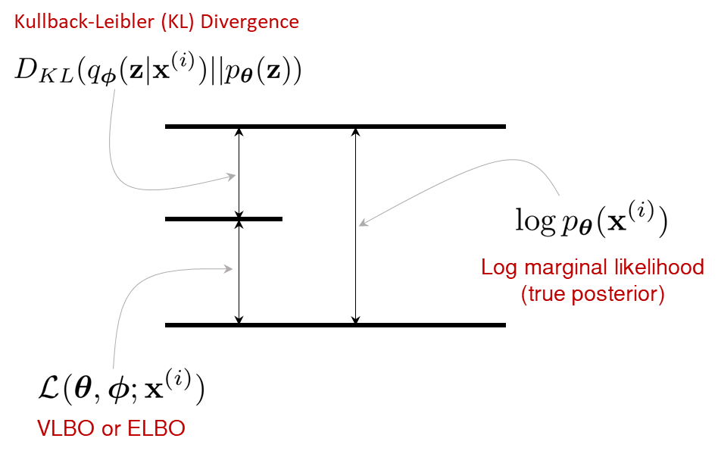
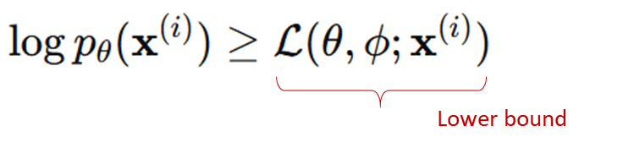
Variational Lower Bound- VLBO (1)
Note: VLBO aka ELBO

Slide 11
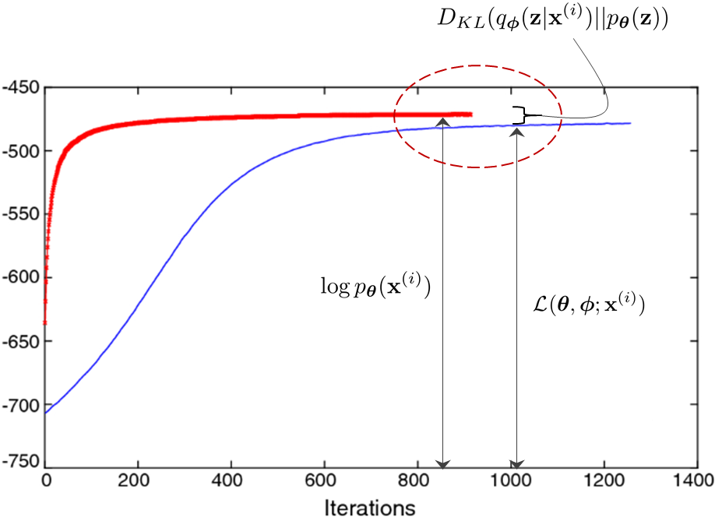
Variational Lower Bound - VLBO (2)
VLBO Maximization
Minimize KL - Divergence
Goal:
Learn ϕ and θ by maximizing the Variational Lower Bound (VLBO), which approximates the log-likelihood of the observed data.

Slide 12
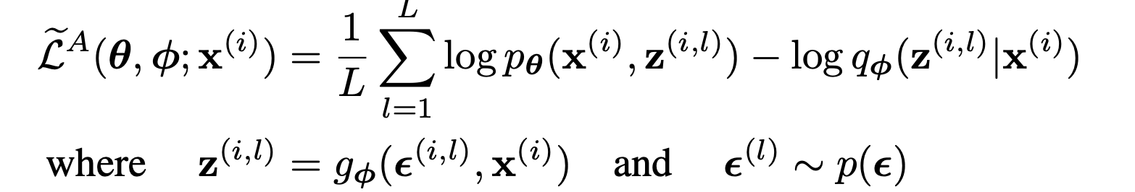
The SGVB estimator and AEVB algorithm
Stochastic Gradient Variational Bayes (SGVB) estimator

Slide 13
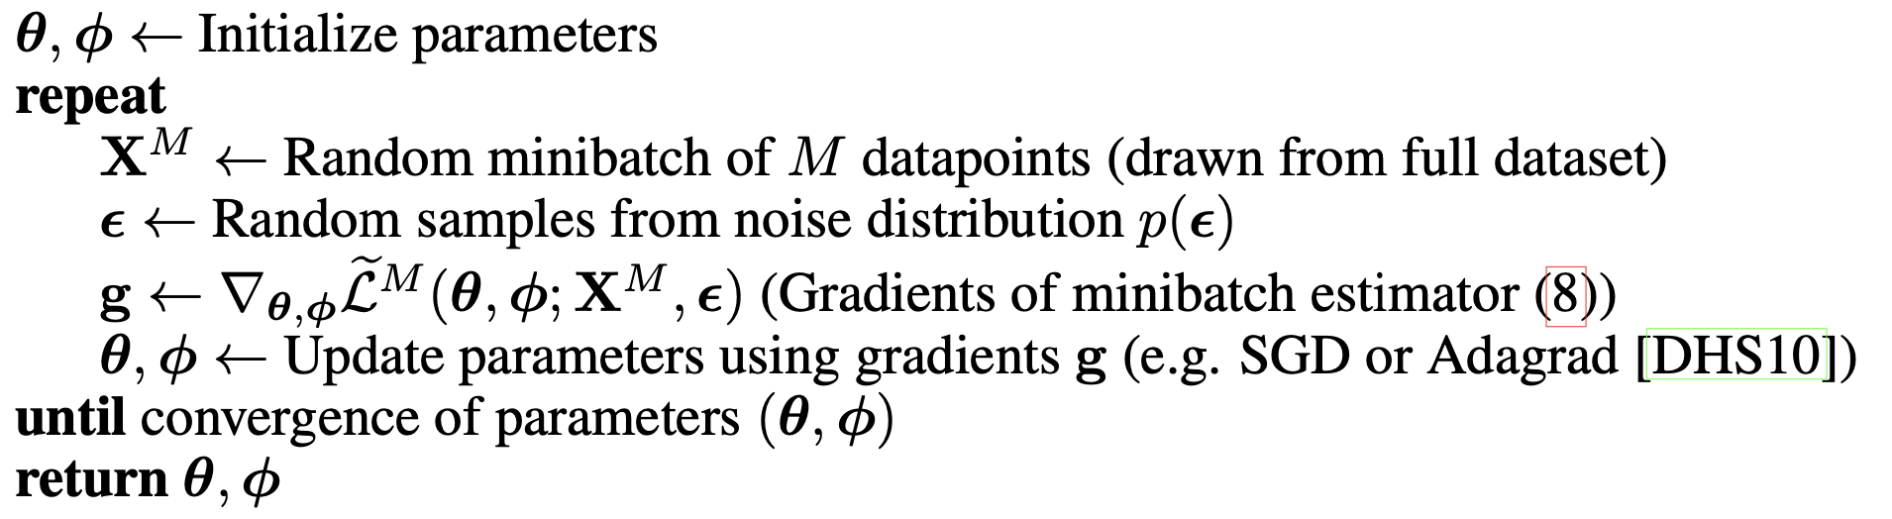
Algorithm to compute the stochastic gradients.

Slide 14
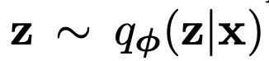
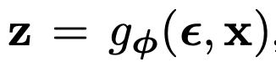
The reparameterization trick
Choosing approaches :
Tractable Inverse CDF.
Analogous to the Gaussian.
Composition: It is often possible to express random variables as different transformations of auxiliary variables.

Slide 15
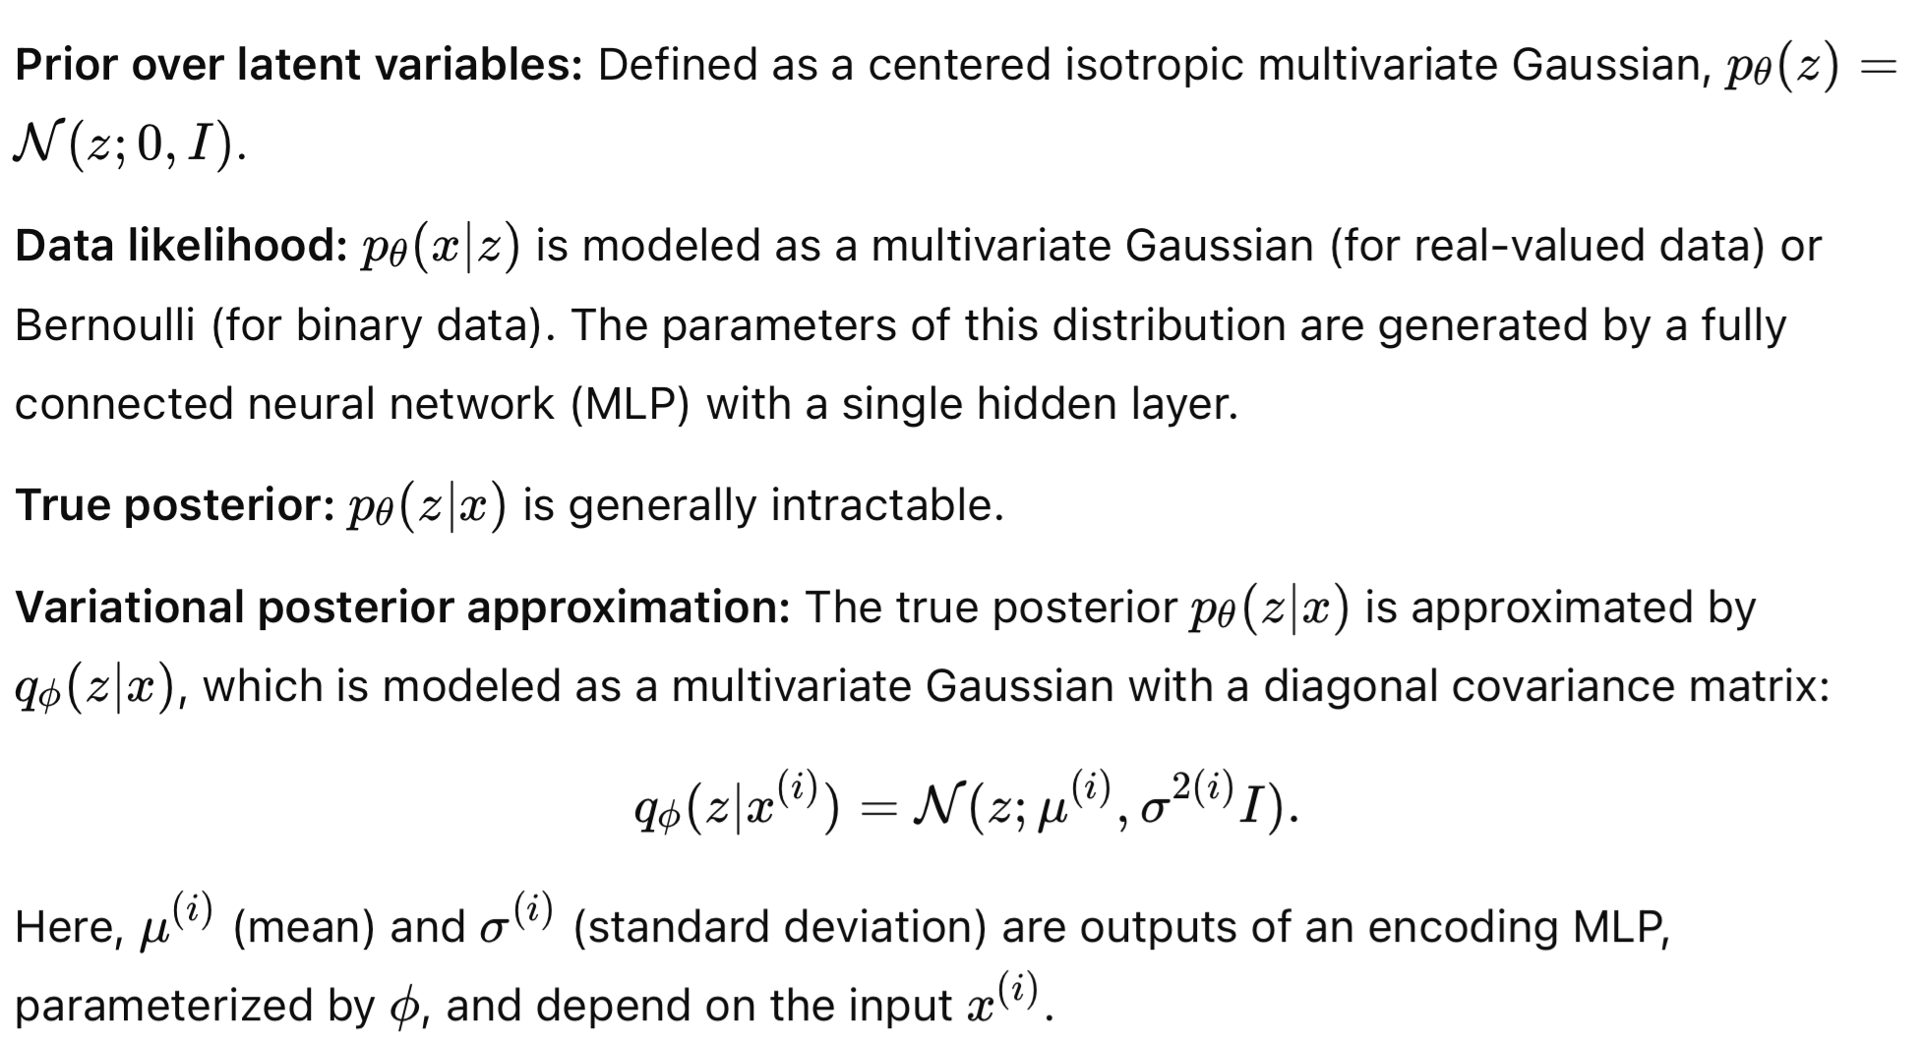
Example: Variational Autoencoder

Slide 16
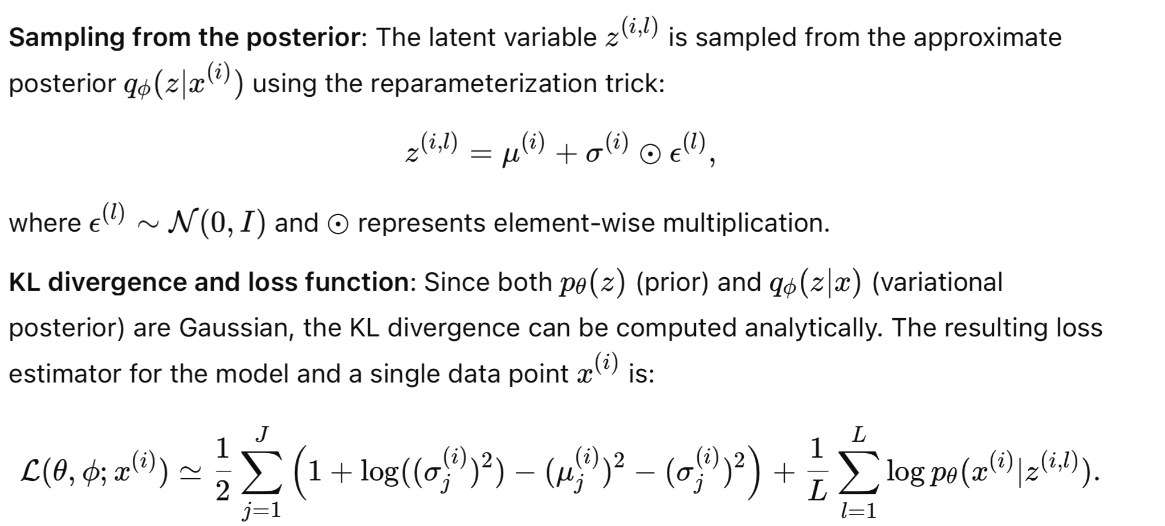
Example: Variational Autoencoder

Slide 17
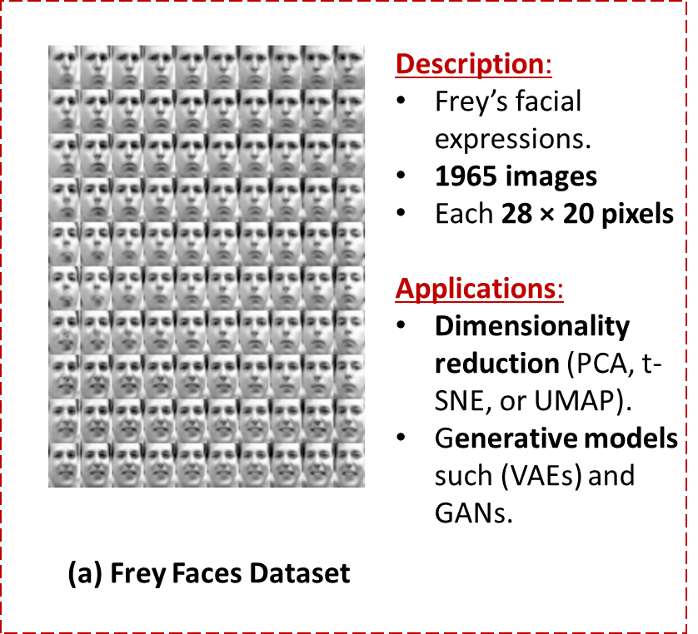
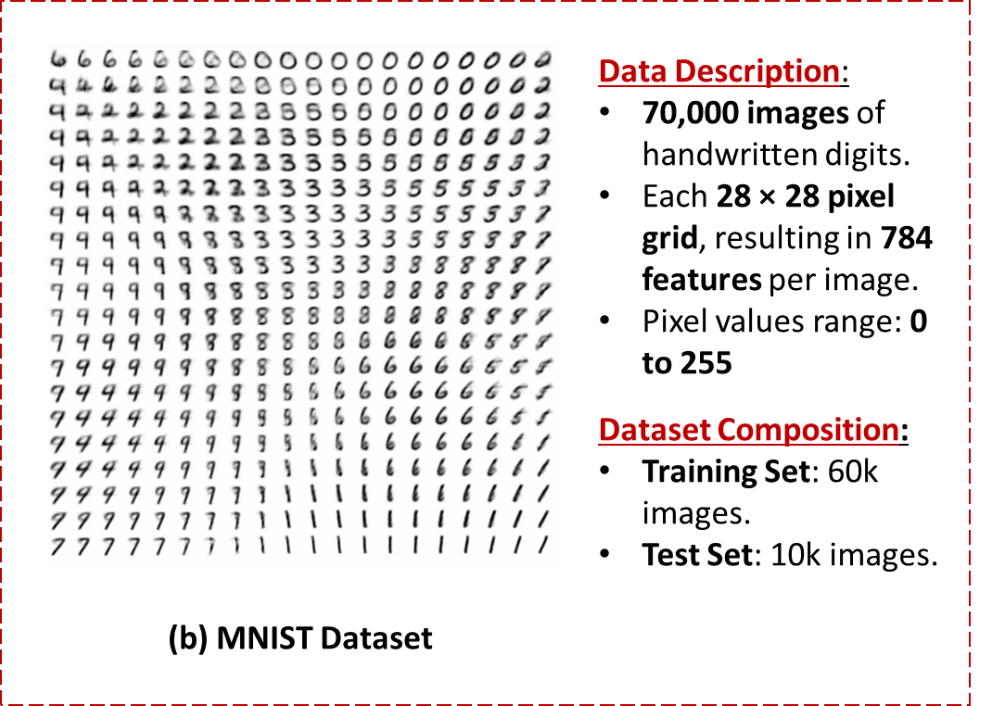
Experiment Setup - Datasets used

Slide 18
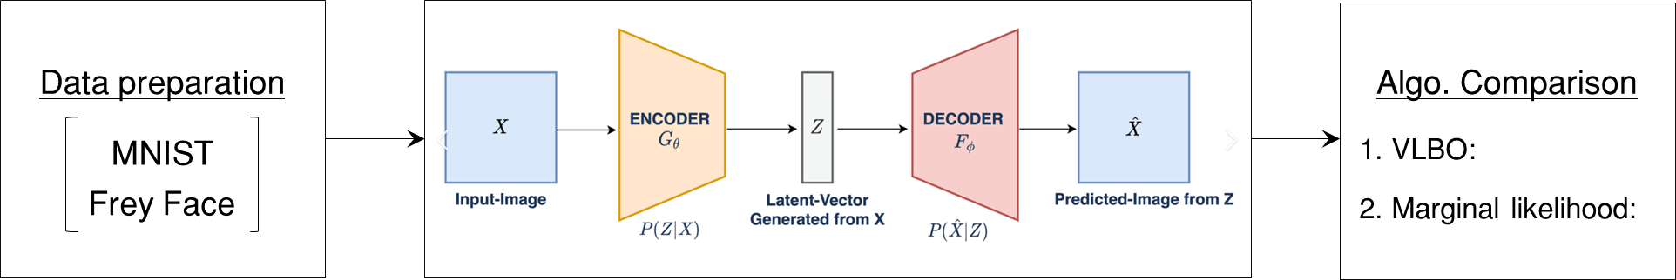
Experiments - Implementation pipeline
VAE approximates latent features based on observed features
VAE reconstructs the observed features from latent variables

Slide 19
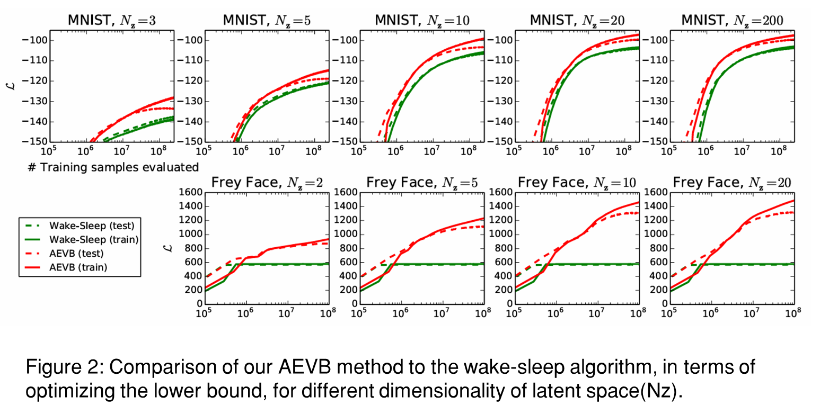
Experiments - Results (1): Likelihood lower bound
In all Experiments
Faster convergence
Reached better solution
More latent variables did not result in more overfitting

Slide 20
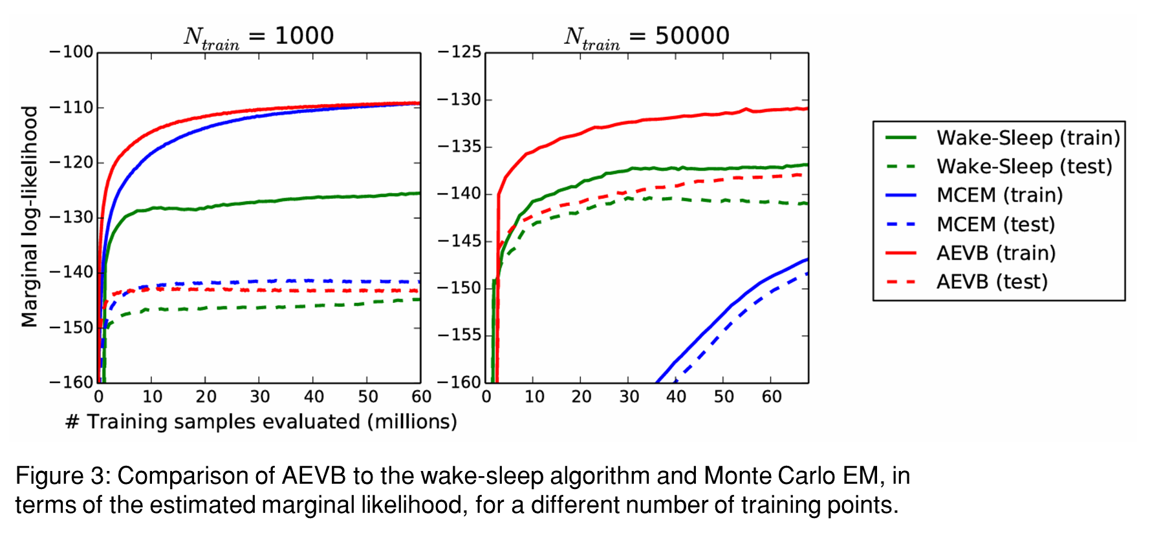
Experiments - Results (2): Marginal Likelihood

Slide 21
Summary
Key Contributions:
Efficient optimization of the Evidence Lower Bound (ELBO) using the reparameterization trick.
Enabled scalable inference for high-dimensional latent variable models.
Paved the way for Variational Autoencoders (VAEs), a widely-used generative model.
Strengths:
Effective complex posterior distributions handling
Flexible and scalable framework for unsupervised learning.
Limitations:
Assumes a factorized Gaussian posterior (simplifying assumption).
Performance can degrade if true posteriors deviate significantly from the assumed form.

Slide 22
Thanks for your attention!

